Slide 1
Professors’ Changing Views of Digital Learning
Results from the 2017 Inside Higher Ed / Gallup Survey of Faculty Attitudes on Technology An Inside Higher Ed webcast Nov. 16, 2017, 2 p.m. EST

Slide 2
Presenters
Doug Lederman, editor, Inside Higher Ed doug.lederman@insidehighered.com
Scott Jaschik, editor, Inside Higher Ed scott.jaschik@insidehighered.com

Slide 3
The Findings

Slide 4
Professors Aren’t Luddites
35% of instructors say they are "early adopters" of new education technologies; 55% say they "typically [adopt] new technologies after seeing peers use them effectively." Just 10% are "disinclined to use educational technologies."
Solid majority, 62%, agree with the statement "I fully support the increased use of educational technologies;" 8% disagree.

Slide 5
As More Professors Teach Online...
Notes:
The proportions were roughly comparable by instructor status -- tenured, nontenured, etc. -- but differed widely by institution type, with public college professors (46 percent) far likelier than their private college peers (21 percent) to have taught online.

Slide 6
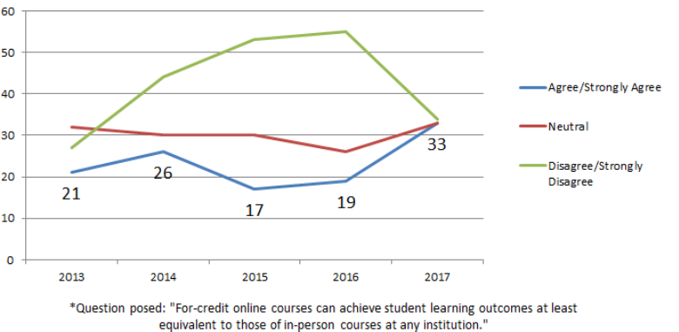
…Belief Grows in Online Efficacy
% of professors who say student outcomes at least as good in online as in-person classes:
Notes:
Forty-five percent of those who have taught online agreed or strongly agreed that the online courses at any institution could achieve student learning outcomes at least as good as in-person courses; the figure for those who had not taught online was 24 percent. The split was even larger for courses at the professors’ own institution (61 percent of those who had taught online versus 28 percent of the rest), and larger still for the instructors’ own courses (65 percent versus 15 percent).

Slide 7
* * (Big Asterisks)
Faculty members believe online courses are less effective at:
Letting instructors interact with students during class time (86%)
Reaching at-risk students (79%).
Rigorously engaging students in course material (60%)
Maintaining academic integrity (60%)
Delivering necessary content to meet learning objectives (51%)

Slide 8
Concerns About Support/Training

Slide 9
Irked by Overpromising

Slide 10
Assessing Assessment
Professors remain convinced that assessment is mainly aimed at satisfying outside forces (accreditors and politicians).
Split on whether assessment efforts have improved student learning and completion.
Pluralities (47% and 43%, respectively) agree that professors are meaningfully involved in planning for use of assessment tools and discussion about assessment information.
But just 30% say they regularly get data from assessments that help them improve their teaching.

Slide 11
Benefits of Teaching Online
7 in 10 instructors who have taught online say the experience helped them develop skills and practices that improved their teaching.
Even more say online teaching has enabled them to think more critically about how to engage students with content, better use multimedia content and better use the learning management system.
Roughly half say they are more comfortable using active learning and project-based learning techniques and better at communicating with students outside class.

Slide 12
Other Findings
Majority of professors and online learning leaders say instructors should significantly consider price when assigning course readings and should assign more open educational resources.
Over 90% of online instructors said they had been involved in designing their courses, but less than half said they had received training to do this, and just under one in four said they had worked with instructional designers.

Slide 13
More About the Survey
Download the survey results:
http://ihenow.com/2jp0PG2

Slide 14
Thanks to Our Sponsors

